Slide 1
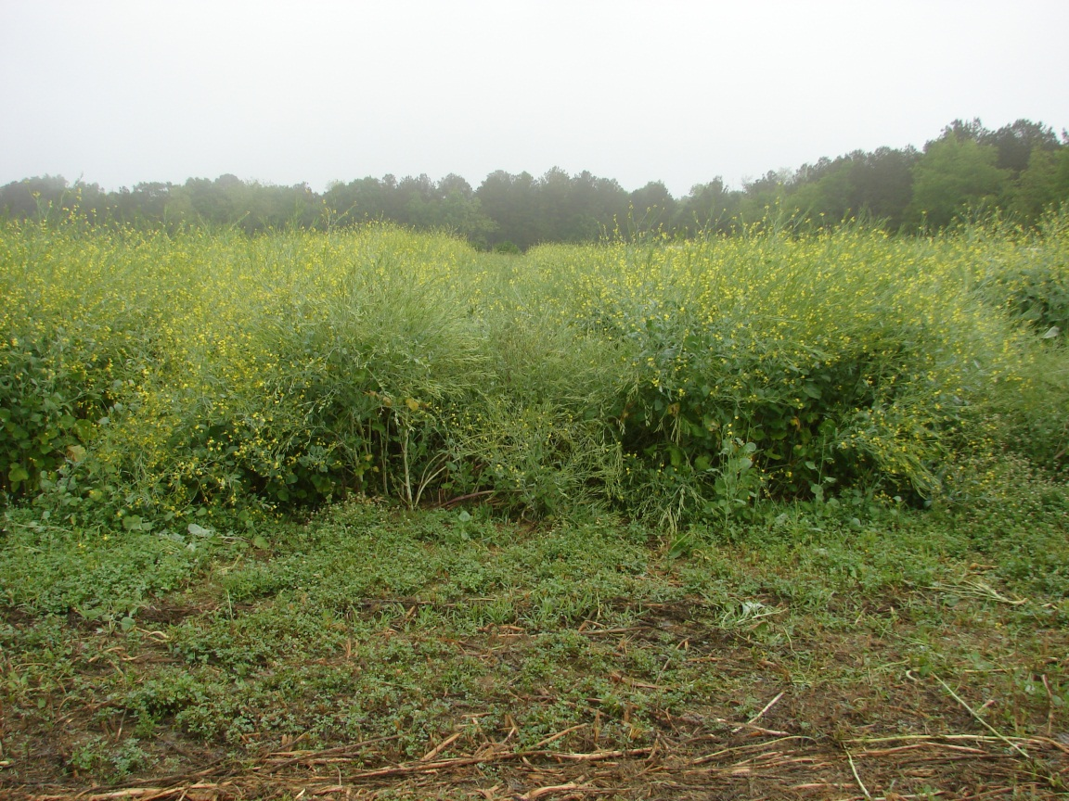
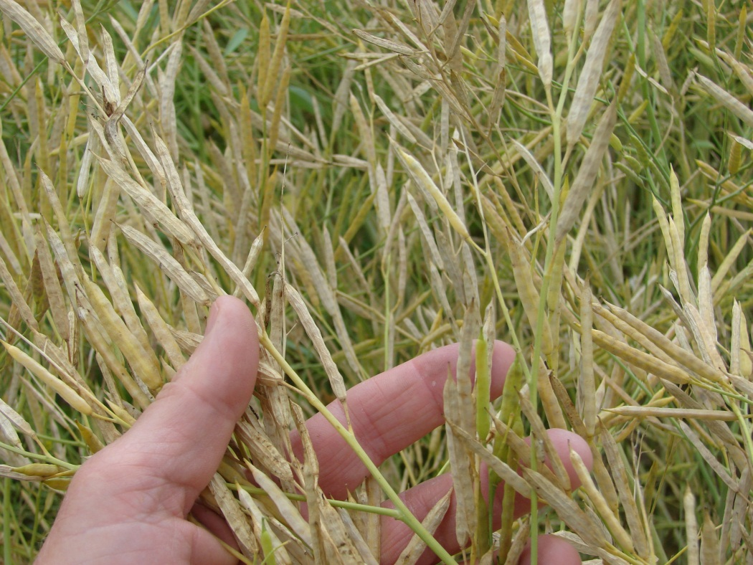
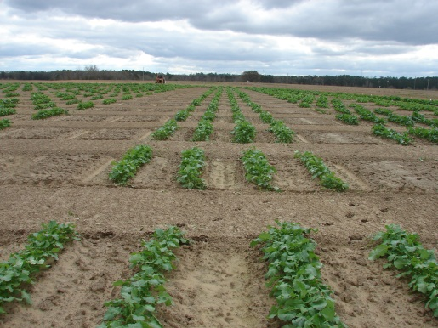
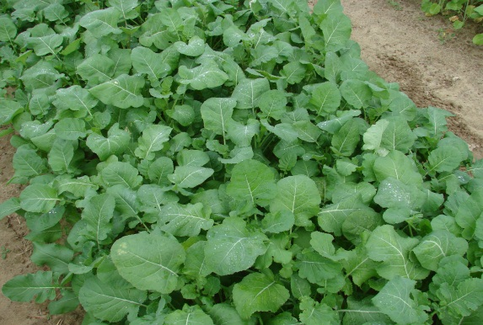
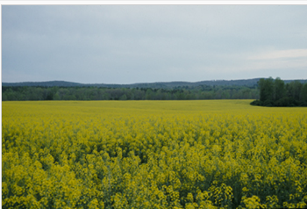
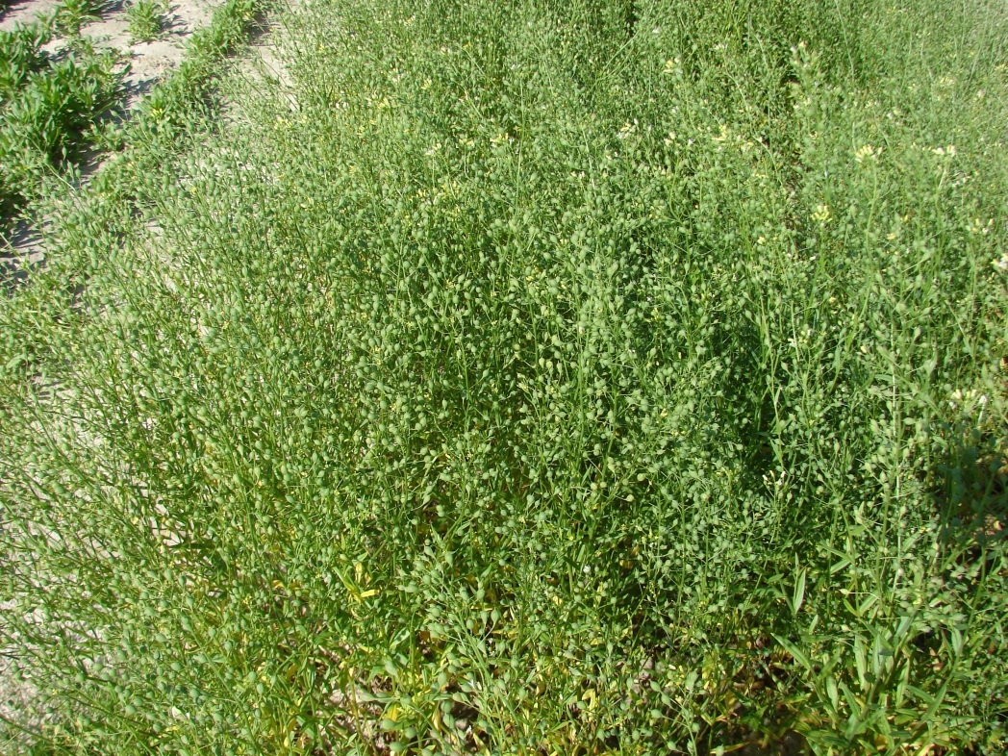
Potential for Oilseed Crops in the Southeast David Wright, J. Marois, S. George, R. Seepaul, C. Bliss
Carinata
Canola
Camelina

Slide 2
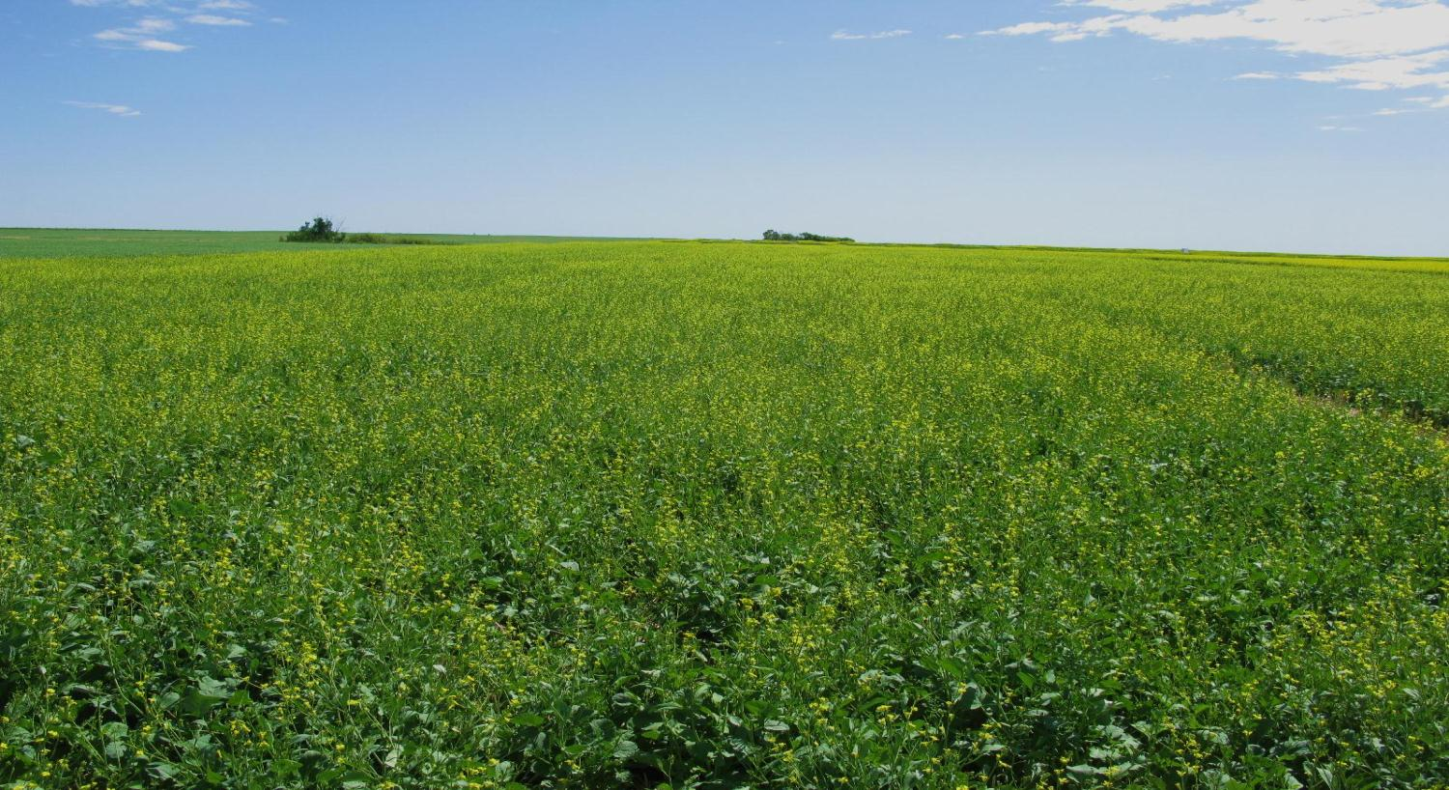
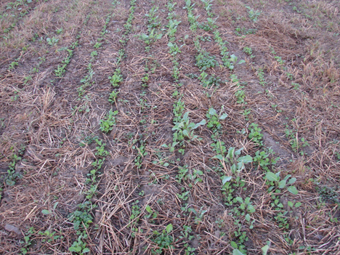
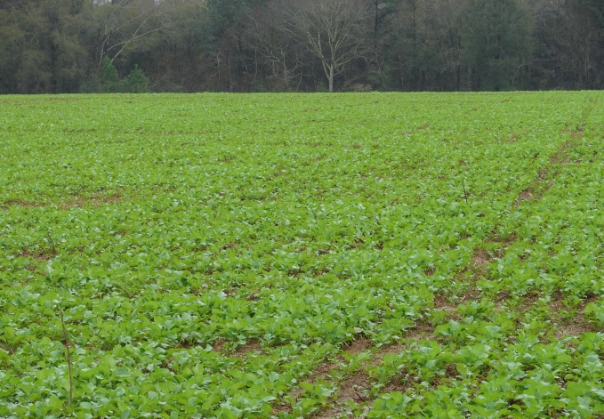
Integrated Feedstock Development and Management of Oilseed
Crops for “Drop-in Biofuels in Florida” FDACS Funding
Applied Research Associates
Agrisoma Biosciences/Mustard 21
University of Florida

Slide 3
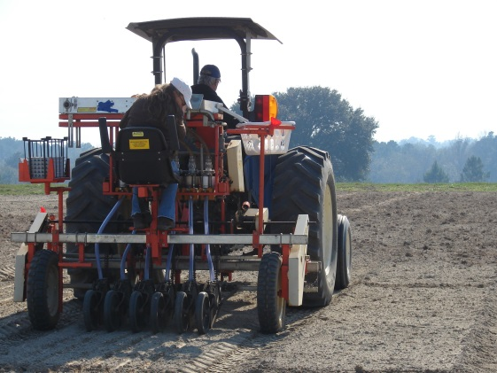
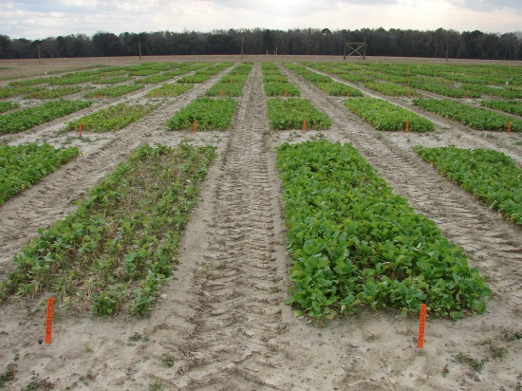
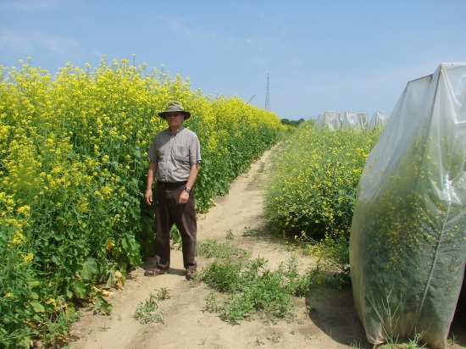
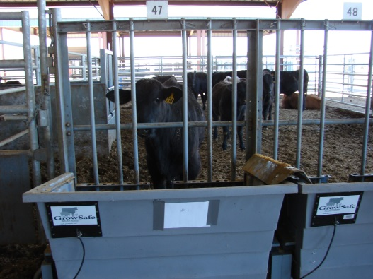
Objectives
Have an oilseed crop that will produce 200 gal/A of oil and be economically viable without subsidies as a winter crop (3500-4000lbs/A seed)
Find short season varieties that can be planted in November and harvested in late April- double cropped or on dormant pastures
Variety must have good oil characteristics and be above 40% oil content
High protein meal with good animal performance
Growers have the ability to make a profit of $300-450/A ( ideal)
Be easy to grow, few pests, relatively low fertilizer requirements,etc. (See poster- R. Seepaul)

Slide 4
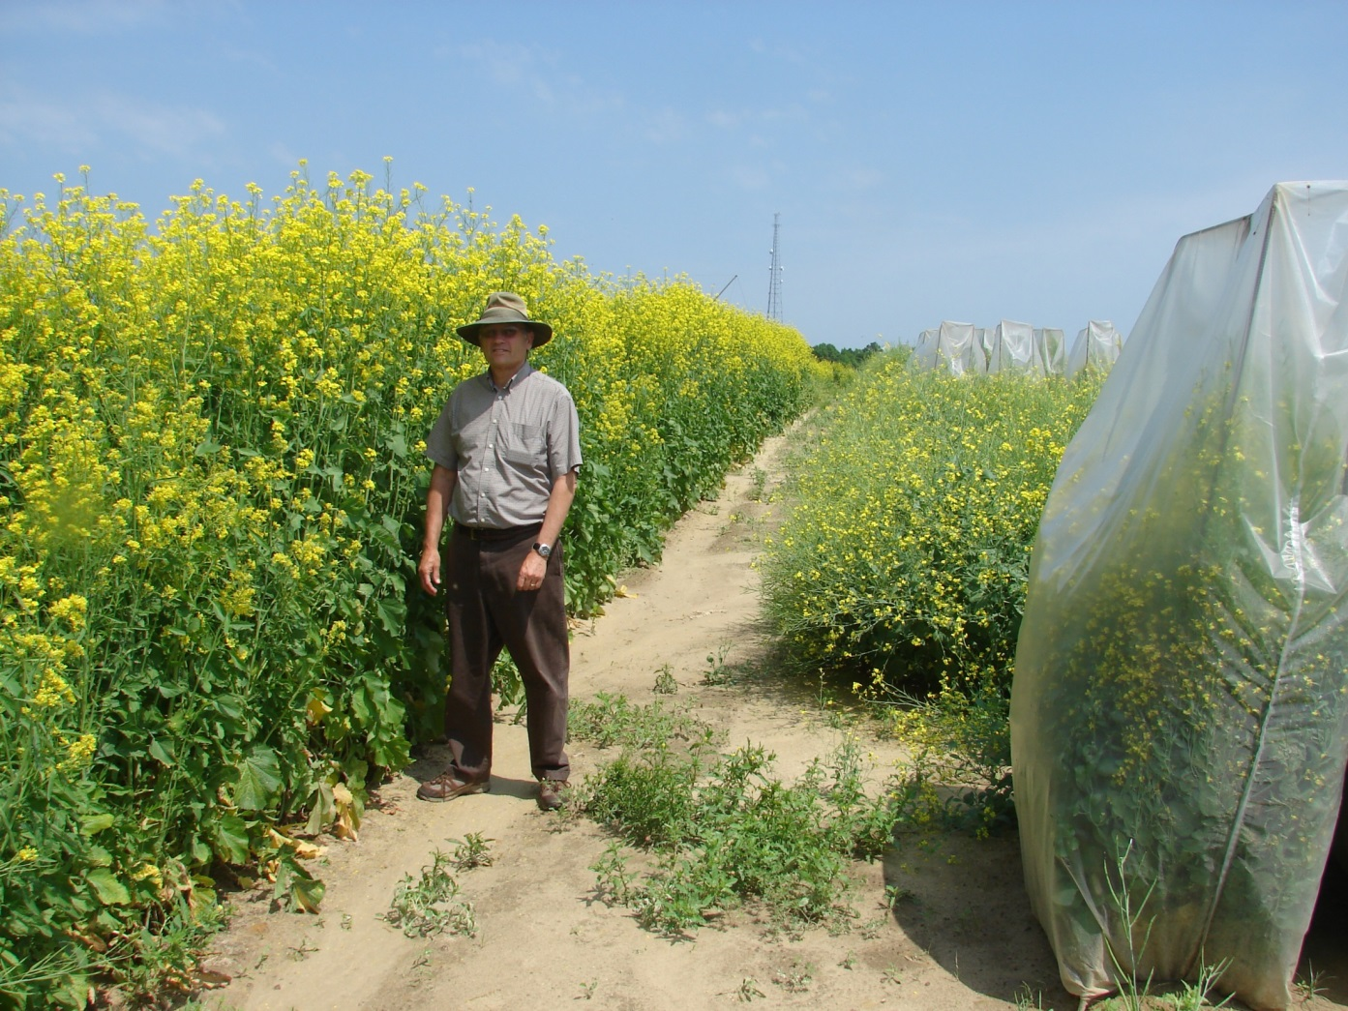
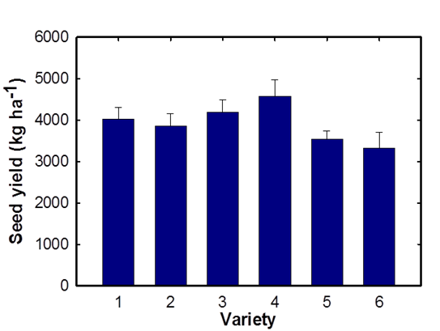
What we will do! Simple Terms
Grow crop- grown around the world
Crush seed
Feed cows
Fly jet

Slide 5
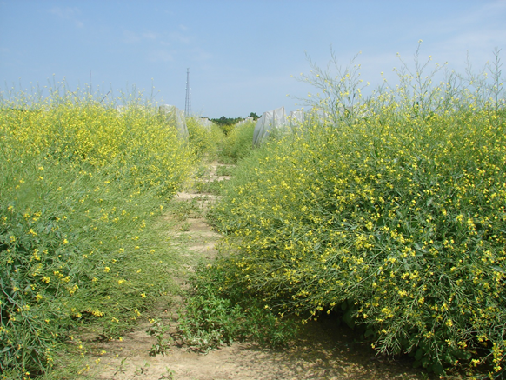
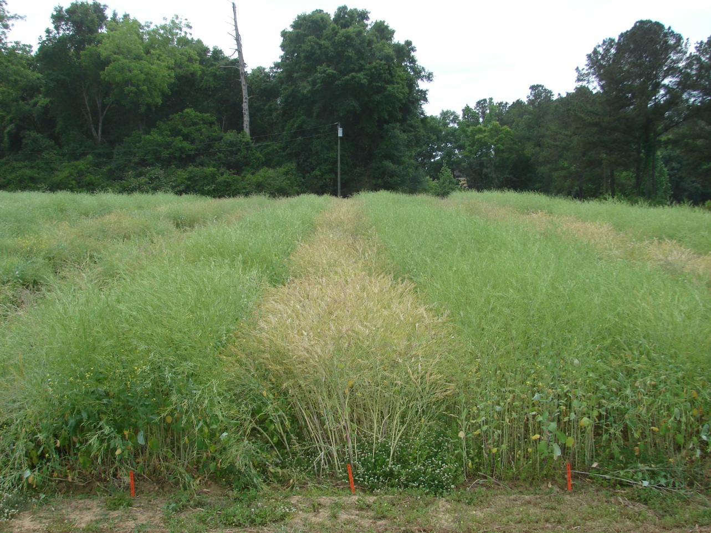
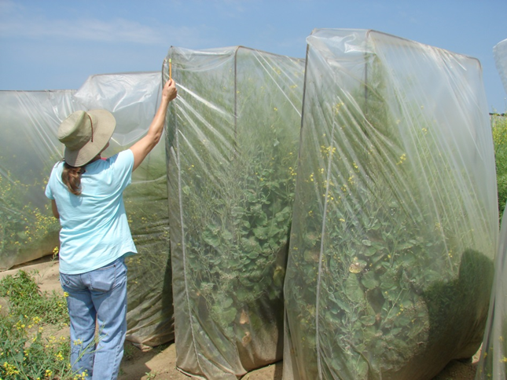
Carinata

Slide 6
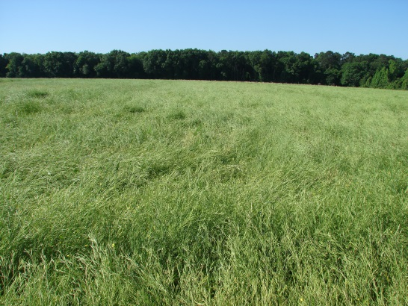
Thank you!
Questions?
22 acres on May 8, 2014
Some winter kill damage

