Slide 1
Biomass Treatment with Supercritical Fluids for high throughput and yield to fuels
Aydin K. Sunol, Kyle Cogswell, Aaron Driscoll, and Zachary Cerniga
Chemical and Biomedical Engineering Dep., (EF)₂(ES)₂ Lab.
University of South Florida, Tampa FL

Slide 2
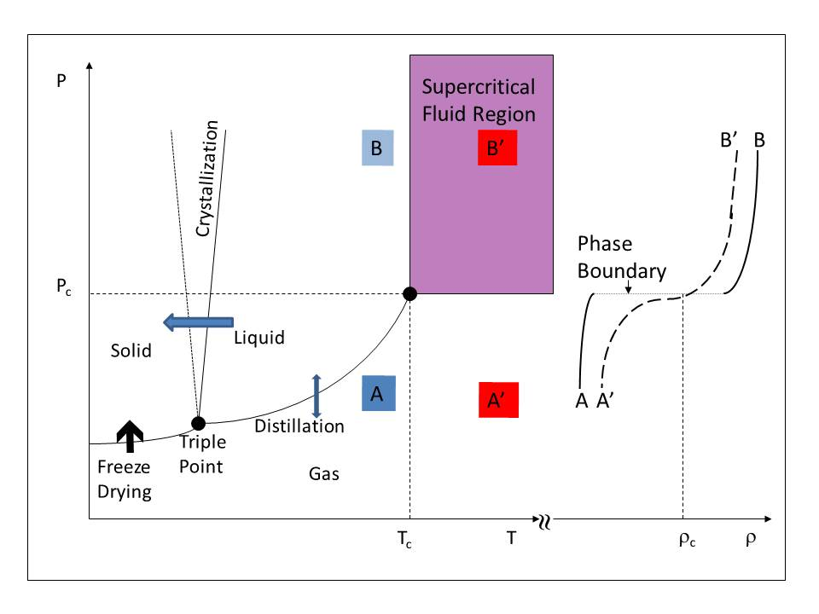
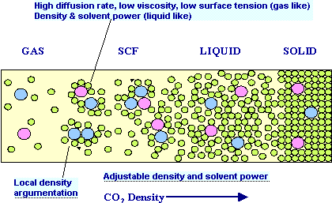
Supercritical Fluids Attractive Green Processing Environment
CO₂: P_{C}= 73 atm; T_{C}= 31.1 ºC H₂O: P_{C}= 217.7 atm; T_{C}= 373.9 ºC
High diffusivity
Low viscosity
low surface tension
High density
High solvent power
Tunable
Non toxic
Non-flammable
Readily available
Inexpensive
Notes:
As we all know, A supercritical fluid is a substance above its critical temperature and pressure, below this critical point, there are two phase co-exist. Liq and vapor. SCF is a very attractive solvent with many outstanding properties.
For example, Carbon dioxide is one of the most popular supercritical fluid, its critical conditions are critical pressure (73atm or 1073 psi) and critical temperature (31.1 °C)

Slide 3
Supercritical Fluids For Pre or Post treatment of Biomass
Pretreatment
Post Treatment
Extraction of High Value Added Products
Extracts have value
Nutraceuticals, food and beverages, medically active compounds, algae
Residue have Value
Pulp
Impregnation of biomass
Catalyst
Composite components (Super Wood)
Combustion
Partial Oxidation in SCW
Gasification to hydrogen or Fuels
Supercritical Reformer and SCW gasification
Liquefaction (Controlled pyrolysis
Conversion to Value added products
Biodiesel

Slide 4
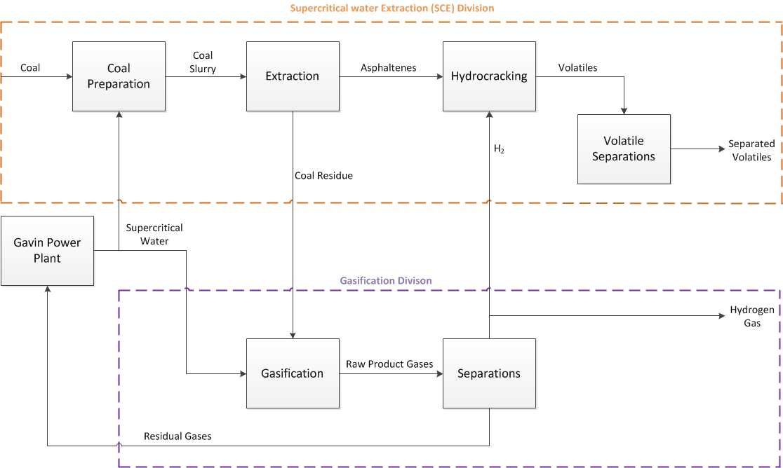
Integrated Power Plant and Hydrocarbon Processing for Chemical and Clean Fuel Production

