Slide 1
d
Politics, Messaging, and Energy Conservation Behavior
of Municipal Utility Customers”
SRN: Integrated Infrastructure Solutions for Developing Environmentally Sustainable, Healthy, and Livable Cities PI & SRN Director: Anu Ramaswami, U. Minnesota
Co-PI Richard Feiock, Florida State University

Slide 2
Energy Test Bed: Tallahassse Florida
What We’ve Investigated So Far…
Energy Consumption Change by DSM Participation
Water Consumption Change by DSM Participation
Energy-Water Nexus in the Consumer’s Home
Who Participates in DSM Programs
Role of Information in DSM Participation Decisions
Effect of E-billing on Energy Consumption
Current Work – Political Economy of Messaging
Future Work

Slide 3
Theme 2 Tallahassee Electric Utilities Test Bed Florida State University (Curley/Feiock)
Program name | Incentive size | Focus
Project Share |  | Community
Change for Change |  | Community
Smart Bill |  | Individual
Energy Audit |  | Individual
Neighborhood REACH |  | Low-income
Ceiling Insulation grants | 80%, up to $400 | Low-income
Energy Efficiency Loans | 5%, 5 yrs, | Home owner
Efficient HVAC Rebates | $100-$750 | Individual
EnergyStar App Rebates | $80-$400 | Individual
EnergyStar Home Rebates | Up to $2,000 | Individual
Homeowner Rehab Loans | Up to $40,000 | Low-income
Natural Gas App Rebates | $50-$700 | Individual
Solar water heather rebates | $450 | Individual
Rehabilitation Grant | Up to $2,500 | Low-income
Energy Efficiency Grants | Up to $500 | Low-income
Good Neighbor | 25% of bill | Seniors
Schools on Solar |  | Community
Nights and Weekends | Varies | Individual
Household Energy Consumption
DSM Participation
Billing type and Call Complaints
Geo-Coded
Merged with Block-Level Census Data
Merged with City of Tallahassee Property Appraisal Data
Notes:
Incorporates years 2004-2016 at the month level
2011-2016 at the 30 min. interval data
The analysis to follow is over the 2004-2011 data. Typically involves a smaller random sample of the data, roughly 4400 homes.

Slide 4
Comparing Consumption Hot Spots

Slide 5
Energy Consumption Analysis
Energy Use
Water Use | .6937011*** (.0156079)
Summer | 321.022*** (2.380428)
Winter | 171.4735*** (2.485254)
Square Feet | .4533561*** (.0095711)
Actual Age | 8.112568*** (.9901225)
Actual Age (2) | -.1084778*** (.0134852)
Audit (n-1) | -36.27835*** (5.947946)
Loan (n-1) | -74.62503*** (16.77973)
Rebate (n-1) | -63.17632*** (12.03436)
2006 | 109.9136*** (5.461875)
2007 | -1.970542 (4.754274)
2008 | -96.76949*** (4.478359)
2009 | -87.60375*** (4.279972)
2010 | 35.52557*** (4.082312)
Constant | 147.0942*** (25.8443)
R-Square
Within | 0.1265
Between | 0.3575
Overall | 0.2987
sigma_u | 455.8841
sigma_e | 434.82167
rho | .52363368
# of Obs | 192186
# of Groups | 4433
Avg # in group | 43.4
Notes:
Loan 1% Rebate 3% Audit 7%
Loan Program 75kwh reductions per participant per hour
Rebate Program 63kwh reductions per participant per hour
Audit Program 36kwh reductions per participant per hour

Slide 6
Energy Consumption Findings
Loan Program 75kwh reductions per participant per month
Rebate Program 63kwh reductions per participant per month
Audit Program 36kwh reductions per participant per month

Slide 7
Comparison of Outcomes between Energy and Water Consumption given participation in DSM
Energy-Water Nexus:
Water-for-Energy
Water used in the production of energy accounts for roughly 15% of the world’s water use (IEA)
Energy-for-Water
Energy used in the production of water accounted for roughly 12.6% of National primary energy consumption in 2010 (Sanders and Webber)
Comparing Consumption reduction between two resources
 | Energy kWh Per Month | Water 100 gallon Per Month
Loan (1%) | -74 | 4.4
Rebate (1%) | -63 | 3.1
Audit (7%) | -36 | -4.5
Yearly Consumption Reductions: | -4,668,000 | -288,000
Notes:
Participation in Energy Policy decreases kWh consumption for participants, while only participation in the AUDIT Program also decreases water.
Since Participation in the Audit program is much larger than the other two programs there is a net benefit of these combined programs to water consumption.
However, In some areas participation in these programs may not have participation rates similar to Tallahassee and their average estimated net benefit may be less.

Slide 8
Who Participates: Examining Characteristics Across Programs
*Comparing Rebate, Loan, and Audit Loan
 | Rebate | Loan | Audit
Energy Use (n-1) | -.0000681 | .0000281 | .0001376***
Minority (%) | -.0028588 | .0029447 | .0010209
Median Income | -.0000125*** | 9.32e-06 | 1.66e-06
Renter (%) | -.0026029 | -.0075682 | -.0002278
Bachelors + (%) | .0096803** | .0059154 | .0030304
Summer | .0726948 | .1099375 | -.0665702
Winter | -.2258686* | -.0815494 | -.142015**
Age of Home | .0187866* | .0501335 | .0050474
Age of Home (sq) | -.0002472* | -.0005911 | -.0000552
Square feet | -.0001444 | -.0001743 | -.0000843
Market Value | 1.36e-06 | -9.60e-07 | 5.15e-08
Constant | -7.569226 | -5.348952*** | -3.276656***
# observations | 77373 | 79490 | 74556
# groups | 1983 | 1985 | 1969
Prob > chi2 | 0.0450 | 0.2793 | 0.0663
Log likelihood | -600.19462 | -209.23402 | -1638.4518
***Includes Information variables as well
Notes:
Census data that Matters for the REBATE: Median income (-), bachelors degrees (+)
Housing stock Characteristics for REBATE: Age of the home
High Bills in previous months increase likelihood of AUDIT

Slide 9
Who Participates: Role of Information Across Programs
Comparing Rebate, Loan, and Audit Loan
 | Rebate | Loan | Audit
Energy Use (n-1) | -.0000681 | .0000281 | .0001376***
Proximity (n-1) | -43.26993** | -152.4943*** | -7.752878**
Public Service Commission (n-1) | -.0028588 | .0061418 | .0059308*
Energy Efficiency (n-1) | -.0380554 | .3183458** | -.0096767
Renewable (n-1) | .0019876 | .01507 | -.0222877
RENEW * EE (n-1) | -.0121094 | -.1197737* | .0061371
PSC * RENEW (n-1) | -.0023633 | -.0120168 | -.0021112
EE * PSC (n-1) | .013487** | -.0725418* | .0001084
Constant | -7.569226 | -5.348952*** | -3.276656***
# observations | 77373 | 79490 | 74556
# groups | 1983 | 1985 | 1969
Prob > chi2 | 0.0450 | 0.2793 | 0.0663
Log likelihood | -600.19462 | -209.23402 | -1638.4518
Notes:
Proximity matters in all cases, being MORE important in the LOAN than any other case. This suggests that participation may be more information dependent in the LOAN program than any of the others.
Information Clusters that matter at the individual Level:
Rebate: Energy Efficienct and Public Service Commission
LOAN: Energy Efficiency is positively related, but and confusion with the messaging (renewables or PSC) and participation decreases.

Slide 10
Findings about Who Adopts
Proximity matters in all cases, being MORE important in the LOAN than any other case.
participation in LOAN more visual cue/peer information dependent
Information Clusters that matter at the individual Level:
Rebate: Energy Efficiency*Public Service Commission
LOAN: Energy Efficiency is positively related, but any confusion with messaging (renewables or PSC) and participation decreases.

Slide 11
Current Research: The Political Economy of Informational Messaging
Research Question
What factors explain the content of messages from local government to citizens regarding energy and conservation?

Slide 12
Information as a Policy Tool
Traditionally research focus on what accounts for the recipient’s response to messaging (Tagg & Dickinson 2008, Curley 2014, Perreault 2014, Smith et al. 2014, Fox et al. 2016), not the content of messaging.
E-gov literature focuses more on perceived quality of information than motivations for information selection (King & Youngblood 2016, Sam & Tahir 2009, Banes & Vidgen 2002)

Slide 13
Designing Messaging
Messaging may be designed to maximize political benefit to internal constituencies.
Messaging may be targeted to adjust recipient behavior
We develop hypotheses around three potential factors that influence message content: Efficiency, Political, and Administrative

Slide 14
Study Context
City governments promote sustainability through Municipally Owned Utility (Portney 2013; Feiock and Coutts 2014; Hamsy 2016)
Programs and policy actions MOUs can take (Portney 2013; Betsill and Bulkeley, 2004; Honsy 2016)
City of Tallahassee Utilities case examined
Communicate with customers through bill inserts
Notes:
Growing literatures in political science, public administration, planning, urban studies, and energy policy address the role that city governments play in promoting environmental sustainability through municipal utilities (Portney 2013; Feiock and Coutts 2014; Hamsy 2016), the types of programs and policy actions they undertake (Portney 2013; Betsill and Bulkeley, 2004; Honsy 2016), and innovative strategies (Xue et al. 2014) that encourage re-municipalization of utilities (Novaro & Bercelli, 2016).
Tallahassee was named the 2012 #1 MOU in the country. They have 100,000 customers and are one of the larger MOU’s in the country. They offer a wide range of different policies.
There is some debate about the read rate of bill inserts. 38% of respondents in a 1992 study said they always read the bill inserts whil 59% said they sometimes read them.

Slide 15
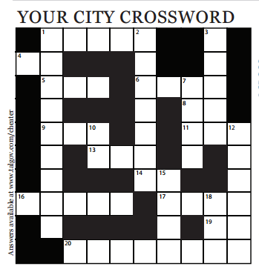
Notes:
Something as innocuous as a utility bill insert delivered every month into your home may have a very specific and intentional message from your local government. In the City of Tallahassee
There are a total of 76 digitally provided bill inserts (2011-2017). We requested access to these in October 2016 and received archived files. We coded the 68 we received that date from January 2011-October 2016. When making this request they decided to start a digital archive and now have posted the rest of these files online. These will be coded in a subsequent study.

Slide 16
Efficiency Hypotheses
E1: Messaging is seasonal-- in summer months it is likely that messaging will be related to coping with heat or cold, energy conservation, insulation, furnace and HVAC and duct maintenance and other activities to decrease peak energy demand.
E2: Following severe weather events there are likely to be messages related to storm sewers, storm damage, power lines, and trash pickup.
E3 In times of drought, messages regarding water conservation and yard irrigation will occur more frequently.

Slide 17
Political Hypotheses
P1a: Change in mayor is likely to produce a shift in message content
P1b Change in city commission composition is likely to produce a shift in message content
P2a: Prior to a mayoral election, there are more mentions of the work done by the Mayor’s Office.
P2b Prior to council elections, there are more mentions of the work done by incumbent council members
P3a Prior to mayoral or council elections, there is a decrease in mentions of politically sensitive terminology (such as climate change)
P3b Prior to mayoral or council elections, economics and cost savings are mentioned more and environmental issues less.

Slide 18
Administrative Hypotheses
A1: City Manager turnover influences the priorities of the city, resulting in changes to the content of messaging
A2a: Substantial administrative reorganization, that centralizes the department responsible for communications, may increase the breadth (and political nature) of messages
A2b Substantial administrative reorganization that decentralizes the department responsible for communications may narrow the scope/focus of message

Slide 19
Table of Events
Events | Date
Hurricane | 9-2016
Severe Storms | 6-2012 (TS Debby)
Drought Concerns | 10-2016; 12-2011
Ice Storm | 1-2011
Seasons | Summer: May-September / Winter: December-February
Commission Composition Change | November 2012, August 2014, November 2016
Mayoral Change | August 2014
Change in City Manager | 11-2015
Administrative Reorganization | 5-2015; 1-2016

Slide 20
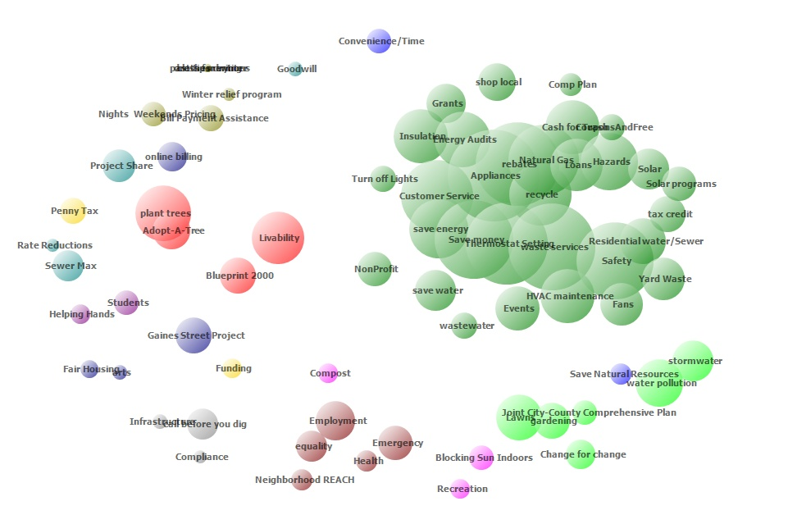
Notes:
After coding these documents we utilized Jaccard’s coefficienct occurrence to mathematically define clusters in our coded data. This helped us to create categories of information that were mathematically alike. We wound up with 9 different clusters.

Slide 21
The 9 Clusters
Table3: Summary Statistics
 | (1) | (2) | (3) | (4) | (5)
VARIABLES | N | mean | sd | min | max
Weather Concerns | 68 | 0.0735 | 0.263 | 0 | 1
Winter | 68 | 0.250 | 0.436 | 0 | 1
Summer | 68 | 0.426 | 0.498 | 0 | 1
Admin Reorganization | 68 | 0.382 | 0.713 | 0 | 2
Pre-Mayor Election | 68 | 0.0441 | 0.207 | 0 | 1
Post-Mayor Election | 68 | 0.0294 | 0.170 | 0 | 1
Pre-Commission Election | 68 | 0.132 | 0.341 | 0 | 1
Post-Commission Election | 68 | 0.0882 | 0.286 | 0 | 1
City Manager Turnover | 68 | 0.0147 | 0.121 | 0 | 1
Admin Org Mentions | 68 | 6.897 | 3.486 | 2 | 18
Political language used | 68 | 5.735 | 2.612 | 1 | 23
Utility Programming | 68 | 7.206 | 8.858 | 0 | 34
Political Programming | 68 | 0.529 | 1.113 | 0 | 8
Energy Tips | 68 | 4.279 | 5.691 | 0 | 29
Solid Waste | 68 | 3.265 | 4.484 | 0 | 27
Economic Development | 68 | 2.015 | 4.098 | 0 | 24
Water Pollution | 68 | 1.941 | 3.489 | 0 | 19
Motivational Language | 68 | 4.294 | 6.469 | 0 | 36
Administrative Organizations Mentioned
Political Language Used
Utility Programming
Political Programming
Energy Tips
Solid Waste
Economic development
Water Pollution
Motivational Language
Notes:
Administrative Organizations Mentioned: animal services, energy services, department of communications, redevelopment agency,
Political Language and Entities: elections, league of women voters, mayors office
Utility Programming: Rebates, Loans, Grants, SolarPV, tax credits for efficiency, winter relief programming
Political Programming: rate reductions, penny tax, joint city county comprehensive planning, blueprint2000
Energy Tips: Blocking sun indoors, shade, dress for winter, fans, hvac maintenance
Solid Waste: yard waste, waste services, hazardous waste, recycle
Economic development: employment, events, funding, gaines street project, shop local
Water Pollution: run-off, lawns, gardening, storm water
Motivational Language: save energy/water/money, equality, livability

Slide 22
Model Specification(s)
DV: Sum of codes in cluster (or) proportion of codes in cluster/total codes in case
IV: Weather Concerns, Winter, Summer, Administrative reorganization, Mayoral election approaching, City Commission election approaching, New Mayor Elected, New City Commission members elected, City Manager Turnover
Controls: Year Binaries, total word count and total codes in case

Slide 23
Efficiency Hypotheses
E1: Messaging is seasonal--summer months tend to increase the frequency with which administrative organizations and political programming are discussed
E1: Messaging is Seasonal--number of utility programs discussed in these communications decreases in comparison with other times of year
E2&3: Weather Events--solid waste discussion seems to increase likely related to yard waste, debris, flooding and sewer overflow concerns
Notes:
We find some support that seasonality is relevant in defining messaging. Particularly that summer months tend to increase the frequency with which administrative organizations and political programming are discussed (all else being equal). The analysis also reveals that the number of utility programs discussed in these communications decreases in comparison with other times of year. Although this may seem counter-intuitive, it is due to the decreasing variety of utility programming discussed within the bill insert during the cooling months. This is likely an attempt to focus on tips and programs that have the largest impact on summer’s peak demand.
Political activity mentions seem to increase in months with severe weather events when controlling for the proportionality of coding, when controlling for years this effect seems to diminish, possibly because of the election cycle in the city. However, in two of our three model specification severe weather events seem to increase messaging around solid waste. This is likely related to the predictability of severe storms and concerns related to yard waste, debris, flooding and sewers.

Slide 27
Political Hypotheses
P1a: Post Mayoral Election – increase in political programming, decrease in motivational language (equality, livability)
P1b Post City Commission Election– increase in motivational language use
P2a: Prior to a mayoral election—some weak support for increase in mentions of energy tips
P2b Prior to City Commission Election—some support for increase in political language used (elections)
P3a Politically Sensitive Terminology—this was generally absent from bill inserts—very few mentions of sustainability, no mentions of climate change throughout the 68 billing inserts
P3b Increased discussion of Economic Development Plans—it appeared that elections had no impact on when economic issues were discussed

Slide 28
Administrative Hypotheses
A1: City Manager turnover—No support for this hypotheses (only one event during time period)
A2: Substantial administrative reorganization (centralizing)—Model specification has a big impact on this variables significance, likely due to current time frame mirroring 2016 dummy variable. Reorganization may potentially influence solid waste discussion; we may be missing an event in this time period (i.e., capacity concerns)
Notes:
A2: Substantial administrative reorganization (centralizing)—Experienced only one large reorganization event near end of time period, change from TU billing insert to Tallahasee Monthly newsletter happens at very end of time period

Slide 29
Future Work
Investigate Influence of Messaging on Program Participation
Investigate the Influence of Messaging on Energy and Consumption Behavior
Analysis of Energy Auditor Comments

Slide 30
FSU Local Governance Lab http://localgov.fsu.edu

Slide 31
Summary Statistics
Variable | Observation | Mean | Std. Deviation | Min | Max
Energy Use | 196,684 | 1200.57 | 774.1945 | 0 | 13840
Summer | 196,684 | .3199091 | .4664422 | 0 | 1
Winter | 196,684 | .2568384 | .4368906 | 0 | 1
Minority | 196,684 | 26.62446 | 28.5407 | 0 | 100
Median Income | 192,186 | 46745.94 | 23004.75 | 4937 | 118464
Lag ebill | 196,684 | .2418803 | .4282233 | 0 | 1
Actual age | 192,186 | 27.68625 | 17.70681 | 0 | 111
Lag rebate | 192,186 | .0105783 | .1023057 | 0 | 1
Lag loan | 192,186 | .011005 | .104326 | 0 | 1
Lag audit | 196,684 | .072768 | .2597561 | 0 | 1
High bill | 196,684 | .0296364 | .1695824 | 0 | 1
Market value | 196,684 | 172530.4 | 109952.2 | 9656 | 1644881
Size of home | 196,684 | 1738.274 | 761.1957 | 0 | 10835
Percent renter | 181,134 | 25.19553 | 25.57755 | 0 | 100
Marketvalue2 | 196,684 | 4.19e+10 | 8.71e+10 | 9.32e+07 | 2.7e+12
Size of home 2 | 196,684 | 3601013 | 4144737 | 0 | 1.17e+08
Mkt value * ebill | 192,186 | 41741.03 | 91962.14 | 0 | 1644881
Actage * ebill | 192,186 | 6.779011 | 15.08902 | 0 | 111
High bill * ebill | 192,186 | .0087103 | .0929219 | 0 | 1
Minority *ebill | 192,186 | 6.362522 | 18.02089 | 0 | 100
Mdninc * ebill | 192,186 | 11487.28 | 23358.76 | 0 | 118464
Loan * ebill | 192,186 | .0024091 | .0490238 | 0 | 1
Audit * ebill | 192,186 | .0162603 | .1264752 | 0 | 1
Rebate * ebill | 192,186 | .0080547 | .089386 | 0 | 1

