Slide 1
High Temperature H₂ Production and Energy Initiatives at UF Energy Park
State of the Union on Florida Energy, University of Florida, Gainesville FL, 3/23/2016

Slide 2
Paths to Solar Fuel Production
Energy Input
Process
H₂O/CO₂
H₂O
CO₂
Photobiological
Solar thermal processes inherently operate at high temperatures and utilize the entire solar spectrum, and as such provide a thermodynamically favorable path to solar fuels production.
Photoelectrochemical
Photons (hν)
Photocatalytic
H₂
CO
+
+
Photosynthesis
CO₂
H₂O
Electricity (e⁻)
Electrolysis
CO+H₂
CO+H₂
CO+H₂
Thermal Energy (U_{internal} = f(T))
Thermochemical
Fischer-Tropsch
Methanation
Synthetic Fuels via

Slide 3
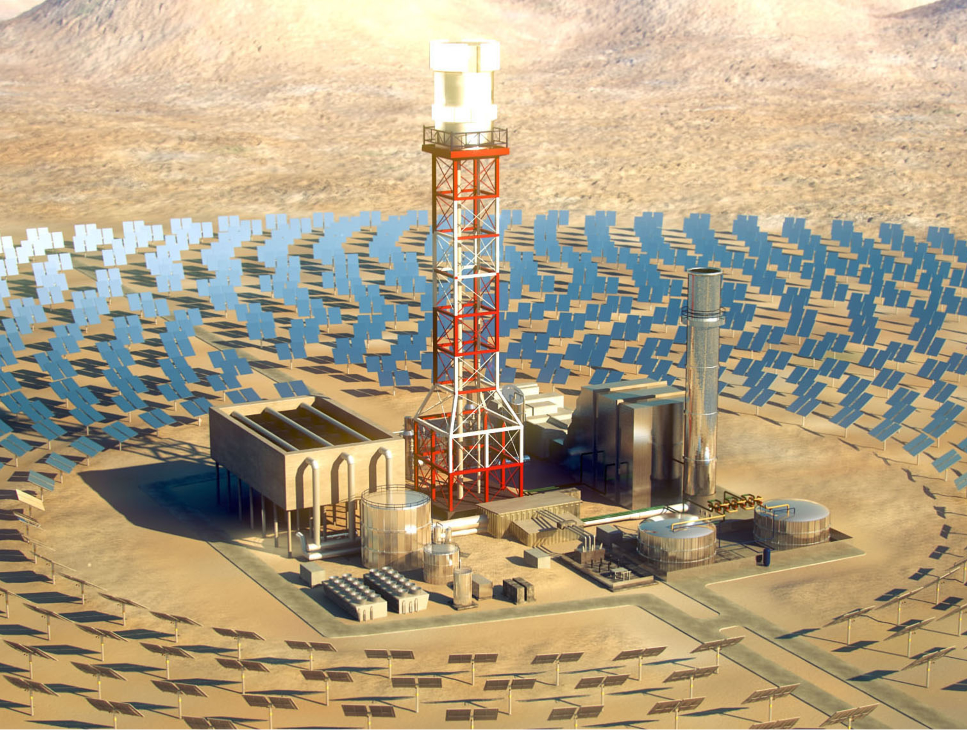
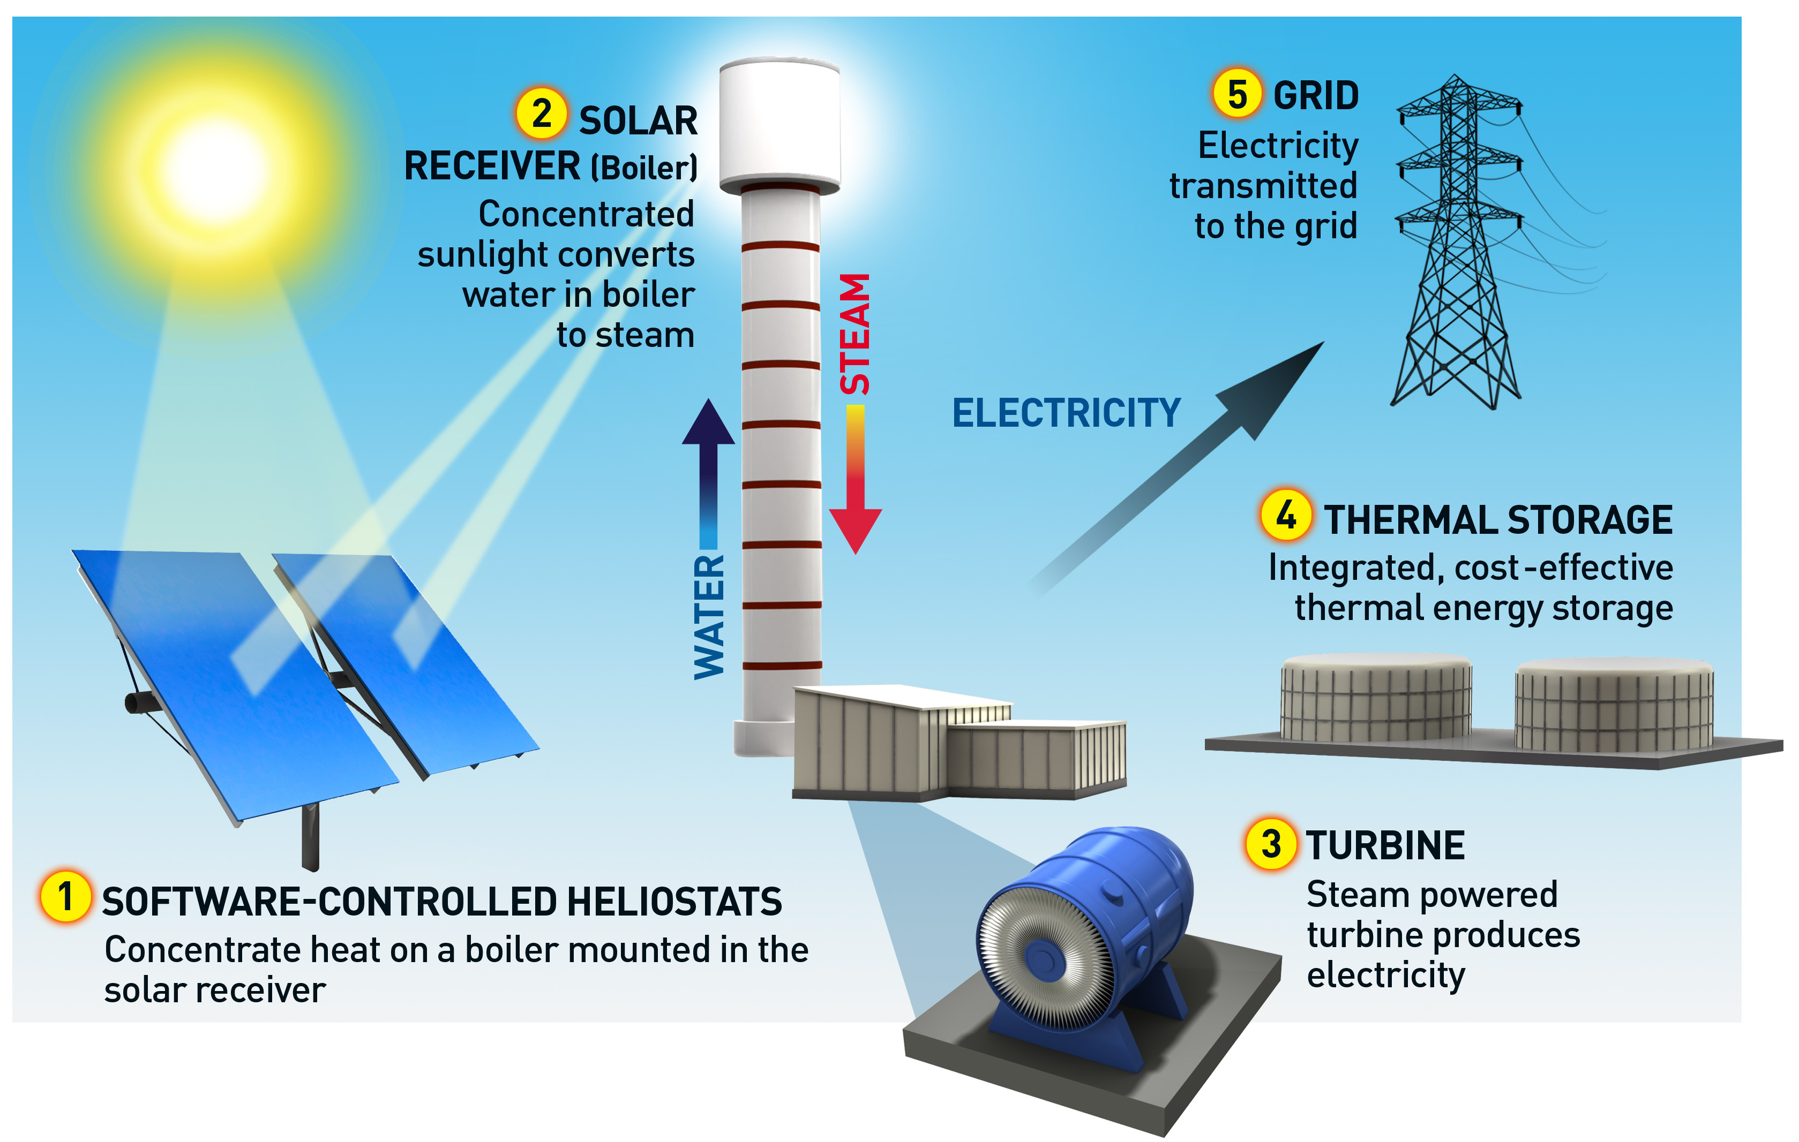
Solar Thermal Electricity Production
Images: http://www.brightsourceenergy.com/

Slide 4
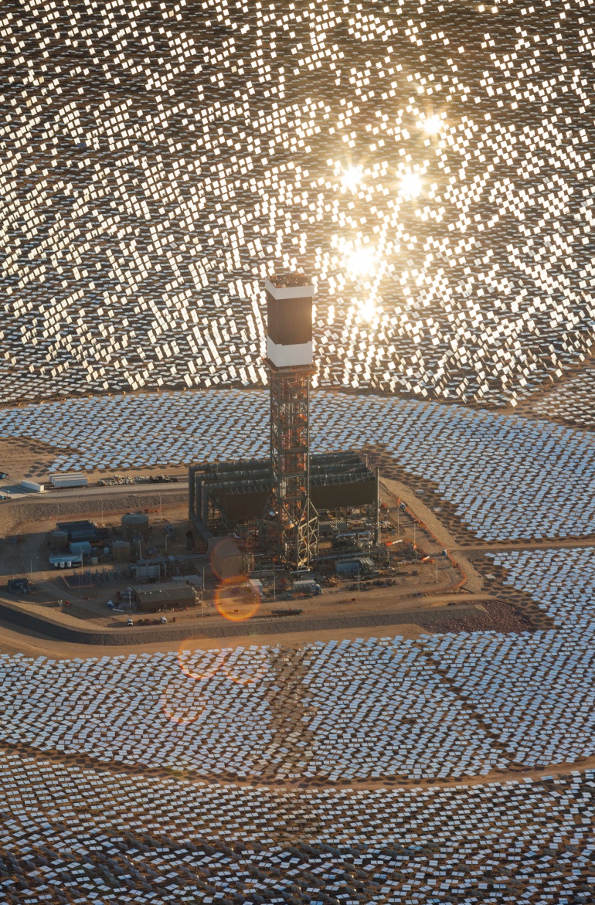
Thermochemical Fuel Production
Solar Concentration
H₂O purification/
CO₂ sequestration
H₂O/CO₂
FT Reactor
High Temperature
Q_{solar}
Chemical Reactor/Receiver
Cracking
Liquid Fuels (diesel, kerosene, etc.)
Heliostat Array
Absorber
Compression
O₂
H₂/CO
Image: http://www.brightsourceenergy.com/

Slide 5
Thermochemical Dissociation of H₂O/CO₂
Two-Step Redox Cycle
1) MO → MO_{1-δ} + δ/2O₂
2) MO_{1-δ} + δH₂O → MO + δH₂
Direct Dissociation
H₂O → H₂ + 0.5O₂
CO₂ → CO + 0.5O₂
Q_{solar}
+Δ
Chemical Reactor
O₂
H₂O/CO₂
-Δ
Direct Dissociation
High temperatures (> 2500 K)
Rapid quenching or separation of products
Two-Step Redox Cycle
Lower temperatures (>1673 K)
Inherent separation of product gases
H₂/CO

Slide 6
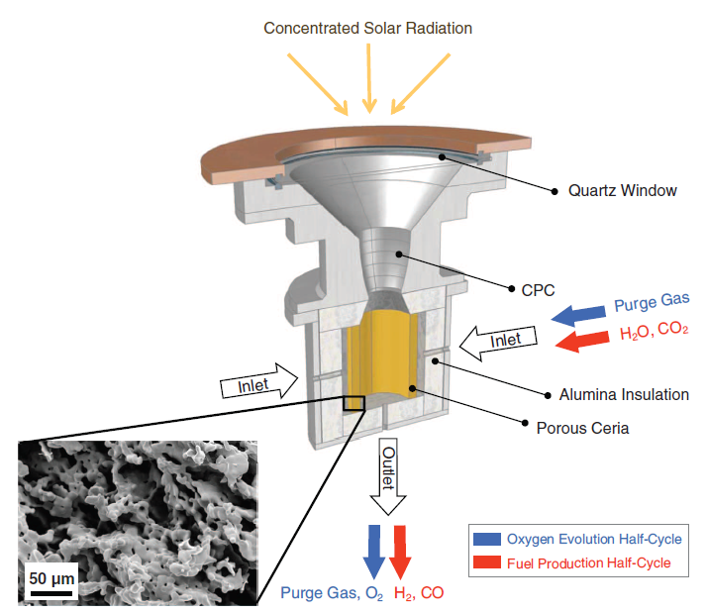
Solar Reactor Technology
2010 – First operable and cyclable solar reactor demonstrating complete redox cycle
Average efficiencies reported ~ 0.6%
Room for optimization in several areas
  Structural optimization
  Reactor optimization
  Material optimization
  Heat recuperation
porous ceria
Chueh, W. C, Steinfeld, A. et al., Science 2010, 330 (6012), 1797-1801.

Slide 7
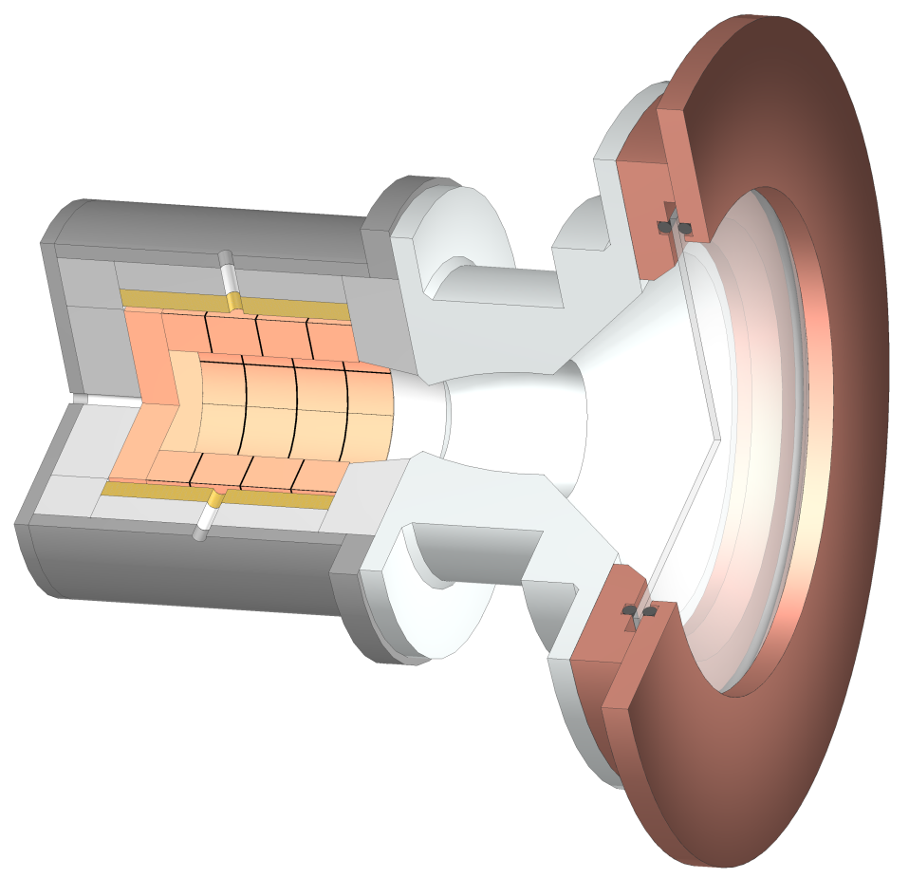
Solar Reactor
Reactor Front (water-cooled)
CeO₂
structure
Reactor
Al₂O₃
insulation
Inlet
Quartz Window
Syngas
(H₂ / CO)
O₂
Concentrated
Solar Radiation
D≈20cm
CO
Outlet
1500 ° C
900 ° C
O₂
H₂
H₂
O₂
Reduction:
Inlet
2. Oxidation:
H≈20cm
Purge Gas (Ar)
H₂O / CO₂
Inconel Shell
Furler, P., Scheffe, J.R., Steinfeld , A., Energy & Fuels 2012, 26 (11), 7051–7059.

Slide 8
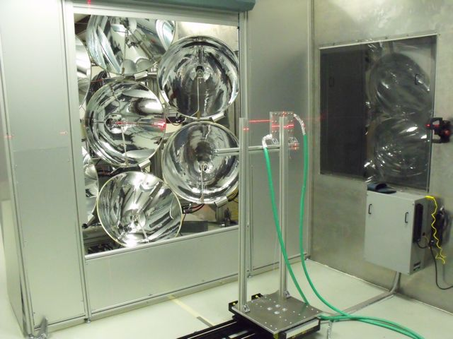
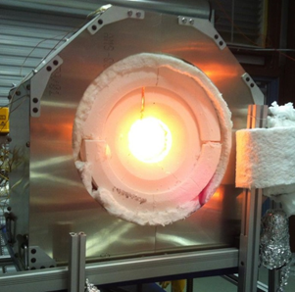
Solar Simulator –
U. Florida

Slide 9
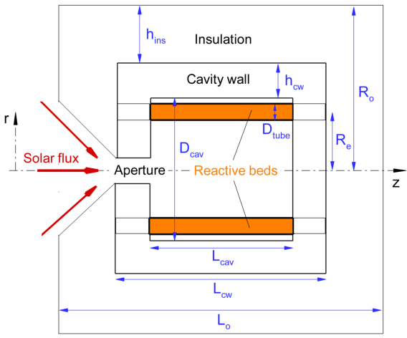
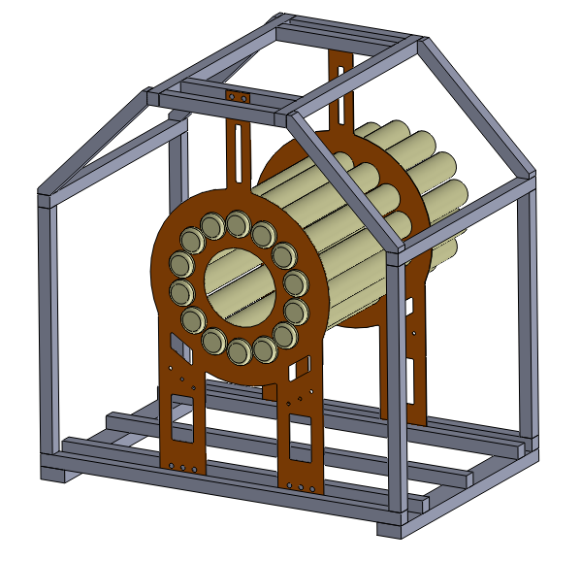
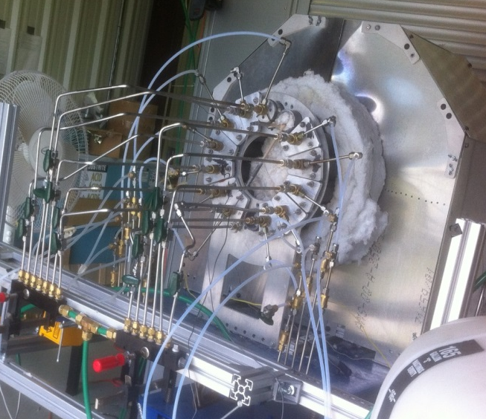

Reactor Prototype
Schematic depiction : cross-sectional view and front view
Rear view
Front view

Slide 10
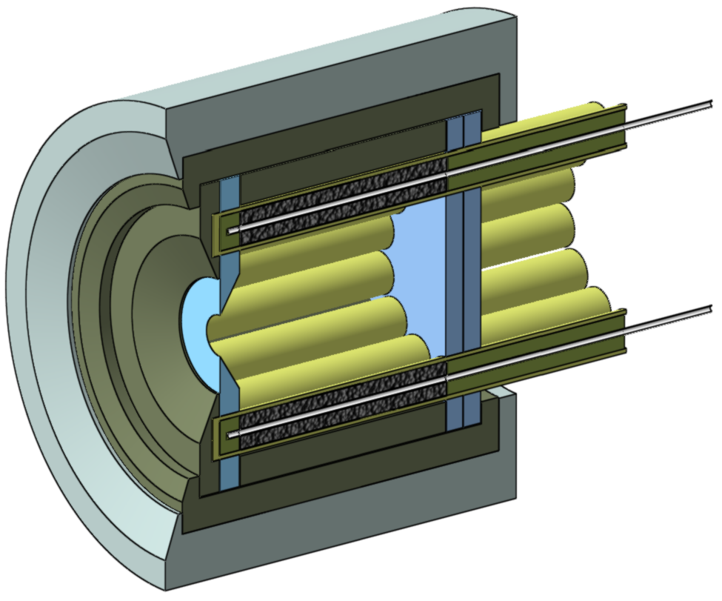
1
4
Reactive material
Reactor tubes
Centre tube ( gas outlet)
Gas inlet
Heated zone
Aperture
High temperature insulation layer 1
High temperature insulation layer 2
Microporous silica
3
2
5
7
8
6
9

Slide 11
Solar Reforming
Q_{red} + δCH₄
δH₂
Solar energy utilization probably greater because of isothermal operation and no separation work
  T_{H} = T_{L} < 1200 K
  Q_{heat} = 0
  E_{sep} = 0
CeO₂
CeO₂
T_{L}
p_{CH4}
p_{H2O}
T_{L}
CeO_{2-δ}
CeO_{2-δ}
2δH₂ + δCO
δH₂O
11

Slide 12
Theoretical Efficiency
Peak at 1100 K because reduction reaction completed above this temperature
No heat recuperation
Further investigation of operating conditions necessary
  n_{i,CH4} = 0.1

Slide 13
Acknowledgements
University of Florida
  Kent Warren
  Richard Carrillo
  Julie Reim
  Ben Greek
  Kelvin Randhir
  Prof. David Hahn
Funding Sources
  ARPA-E
  UF: College of Engineering and MAE

